Slide 2


AI BASED STOCK MARKET PREDICTION USING A STCOKED LSTM
TEAM MEMBERS:
P. SHAHIRA (223H1A3910)
A. NANDINI (223H1A3901)
M. ZAIBAKHANAM(223H1A3907)
K. VARA LAKSHMI (223H1A3905)
S. AFIFA FATHIMA (223H1A3911)
Under the Guidance of:
MS. S. SWETHA, (M .Tech)
ASSISTANT PROFESSOR
Notes:
Under the Guidance of:

Slide 3
ABSTRACT
Uses Artificial Intelligence to analyze stock market data
LSTM model is used for time-series prediction
Learns from historical stock price data
Identifies patterns and trends in the market
Predicts future stock prices with better accuracy
Works for global equity markets
Helps investors make better decisions
Reduces risk compared to traditional methods

Slide 4
EXISTING SYSTEM
Traditional systems use fundamental and technical analysis
Investors must manually analyze charts and financial data
Process is time-consuming
Requires expert knowledge to understand market trends
Most platforms offer only basic visualization tools
Lack of advanced prediction techniques
Cannot efficiently handle large and real-time data
Do not use modern technologies like AI and Machine Learning
Leads to inaccurate predictions and poor investment decisions

Slide 5
DISADVANTAGES OF EXISTING SYSTEM
1. Time-Consuming Process Requires manual analysis of stock data and charts, making it slow and inefficient.
2. Requires Expert Knowledge Users need strong financial understanding to interpret market trends correctly.
3. Human Errors Manual work can lead to mistakes and wrong investment decisions.
4. Low Prediction Accuracy Does not provide reliable future predictions based on data patterns.
5. Limited Use of Modern Technology Lacks implementation of advanced technologies like AI and Machine Learning.
6 Poor Handling of Big Data Struggles to process large volumes of real-time market data efficiently.
7. No Automation Decision-making is manual, which is not suitable for fast-moving markets.
8. Limited Insights Provides only basic information, leading to less effective investment decisions.

Slide 6
PROPOSED SYSTEM
1. AI-Based System . Uses Artificial Intelligence and Machine Learning for stock prediction and analysis.
2. LSTM Model . Applies Long Short-Term Memory (LSTM) for analyzing time-series stock data.
3. Historical Data Analysis . Learns patterns from past stock prices to predict future trends.
4. Real-Time Data Collection . Collects live stock data using APIs like yahooFinance.
5. Technical Indicators Used . Uses indicators such as Moving Averages (MA20, MA50) and RSI for better analysis.
6. Interactive Dashboard . Built using Streamlight to display charts like candlestick graphs and prediction plots.
7. Automated Decision-Making . Provides buy, sell, or hold suggestions based on analysis.
8. Performance Evaluation . Measures accuracy using metrics like MAE and RMSE.
9. Short-Term Forecasting . Generates a 7-day prediction to help in investment planning.

Slide 7
ADVANTAGES OF PROPOSED SYSTEM
Gives more accurate predictions using AI and LSTM
Analyzes large data quickly and efficiently
Uses advanced model (Stacked LSTM) for better results
Automates the entire process (no manual work needed)
Works with real-time stock data
Provides buy, sell, hold suggestions
Has a simple and user-friendly dashboard
Shows clear visual charts for easy understanding
Evaluates performance using MAE and RMSE
Gives 7-day future predictions
Saves time compared to manual analysis
Reduces human errors and improves decisions

Slide 8
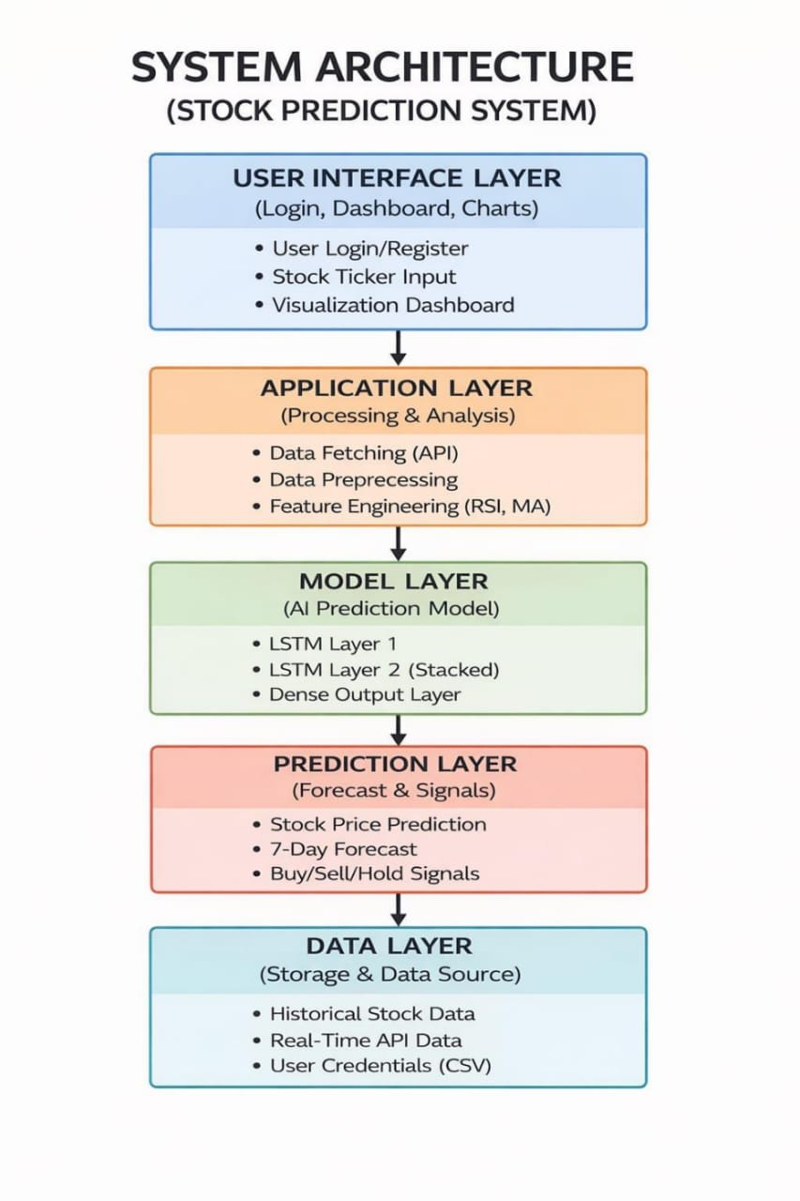
SYSTEM ARCHITECTURE

Slide 9
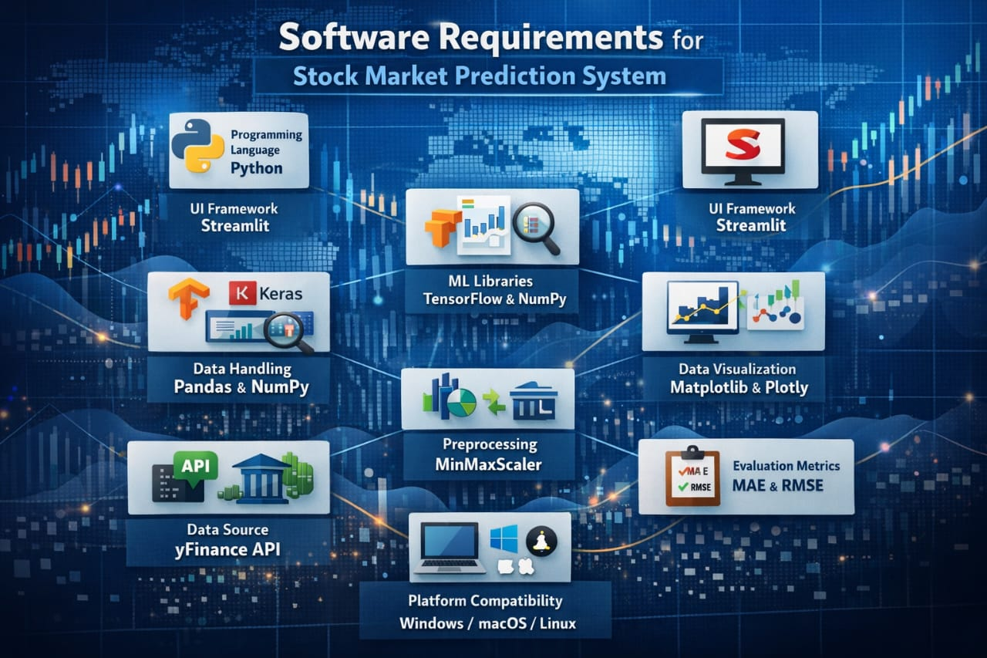
SOFTWARE REQUIREMENTS
Programming Language: Python is used to develop the system
Framework: Streamlite is used to build the user interface
Machine Learning Libraries: TensorFlow and Keras are used for model development
Data Handling Libraries: Pandas and NumPy are used for data processing
Visualization Tools: Matplotlib and Plotly are used for charts and graphs
Data Source API: yahooFinance is used to fetch stock data
Preprocessing Tool: MinMaxScaler is used for data normalization
Performance Metrics: MAE and RMSE are used to evaluate prediction accuracy
Platform Requirement: Works on Windows, Linux, or macOS with internet access

Slide 10
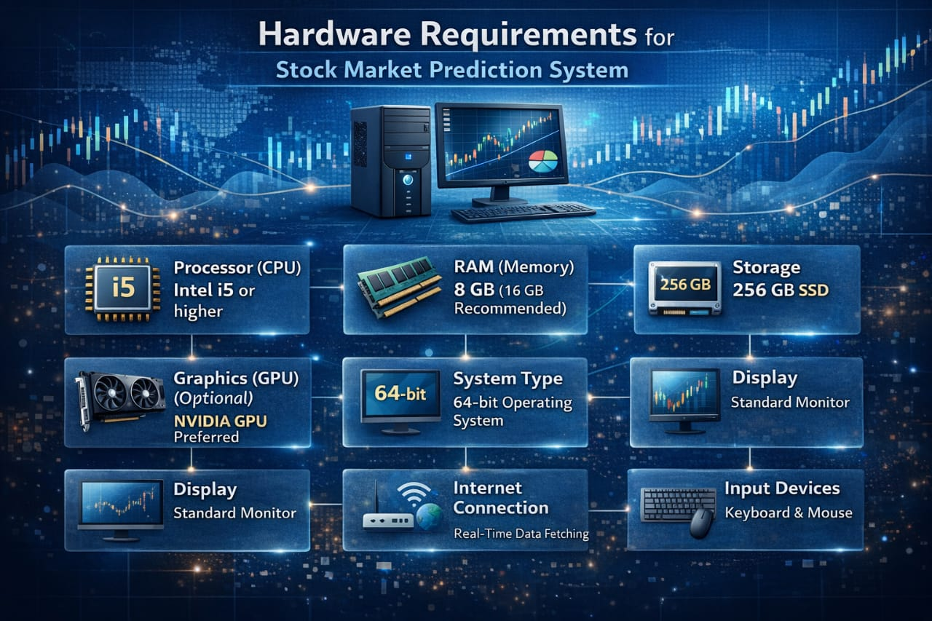
HARDWARE REQUIREMENTS
Processor (CPU): Minimum Intel i5 or equivalent for smooth processing
RAM: At least 8 GB (16 GB recommended for better performance)
Storage: Minimum 256 GB SSD for faster data access and storage
System Type: 64-bit operating system required
Display: Monitor with good resolution for data visualization
Internet Connection: Required for fetching real-time stock data (yFinance API)
Input Devices: Keyboard and mouse for user interaction
Power Supply: Reliable power source for continuous system operation

Slide 11
SYSTEM DESIGN
Use Case Diagram Shows how the user interacts with the system. Example: Login, enter stock symbol, view data, get predictions.
Class Diagram Shows the structure of the system (classes, data, relationships). Helps understand how components are organized.
Sequence Diagram Shows step-by-step communication between system parts over time. Explains how requests move from user to system and back.
Activity Diagram Shows the workflow of the system from start to end. Example: Input → Processing → Output.
Deployment Diagram Shows where and how the system is installed (hardware & software setup).

Slide 12
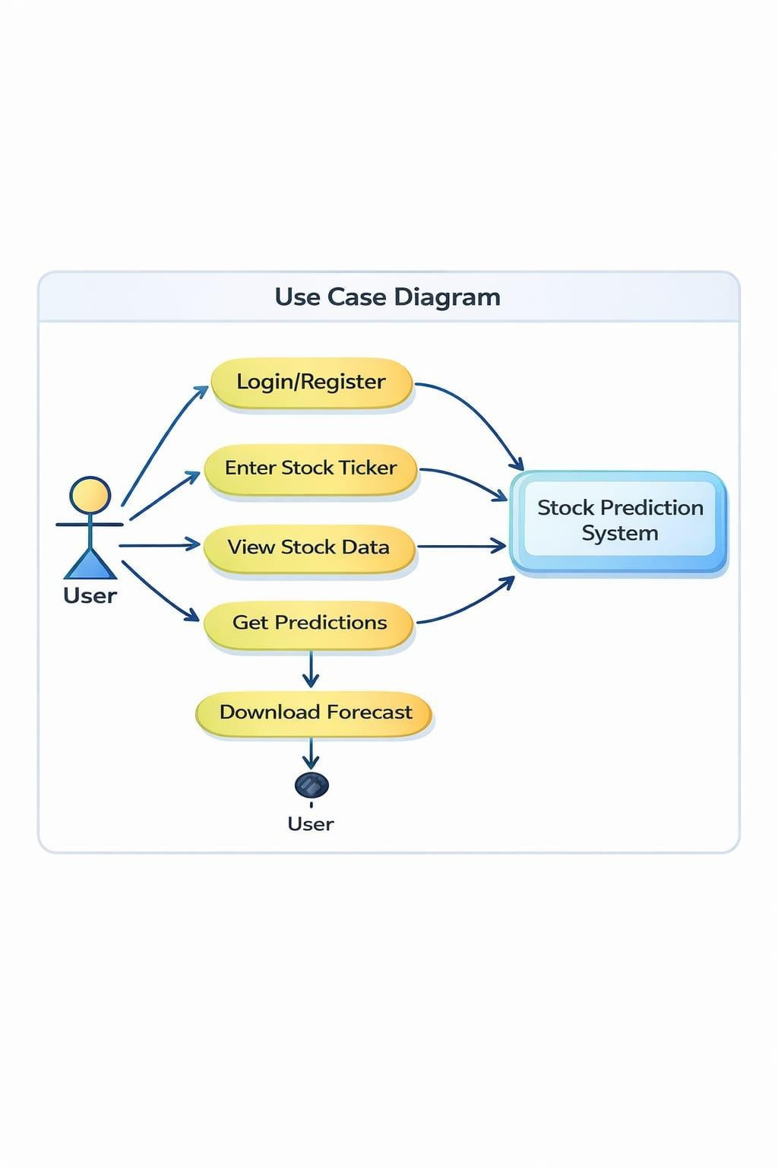
USE CASE DIAGRAM
Enters stock ticker (like AAPL, TSLA)
Views stock data and charts
Gets AI-based predictions
Sees trading signals (Buy/Sell/Hold)
Downloads 7-day forecast

Slide 13
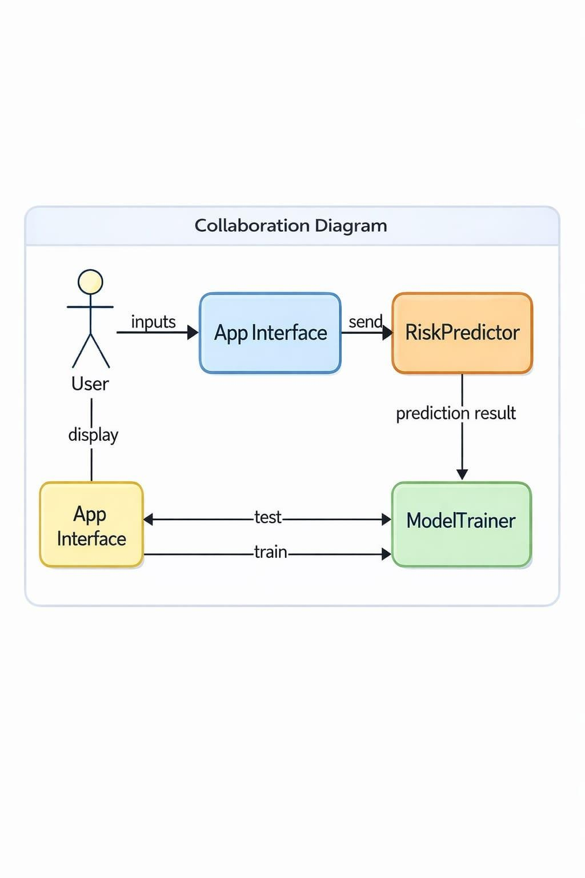
Collaboration Diagram
User gives input through the app
App sends data to system components
RiskPredictor analyzes indicators
ModelTrainer trains LSTM model
System processes and returns results

Slide 14
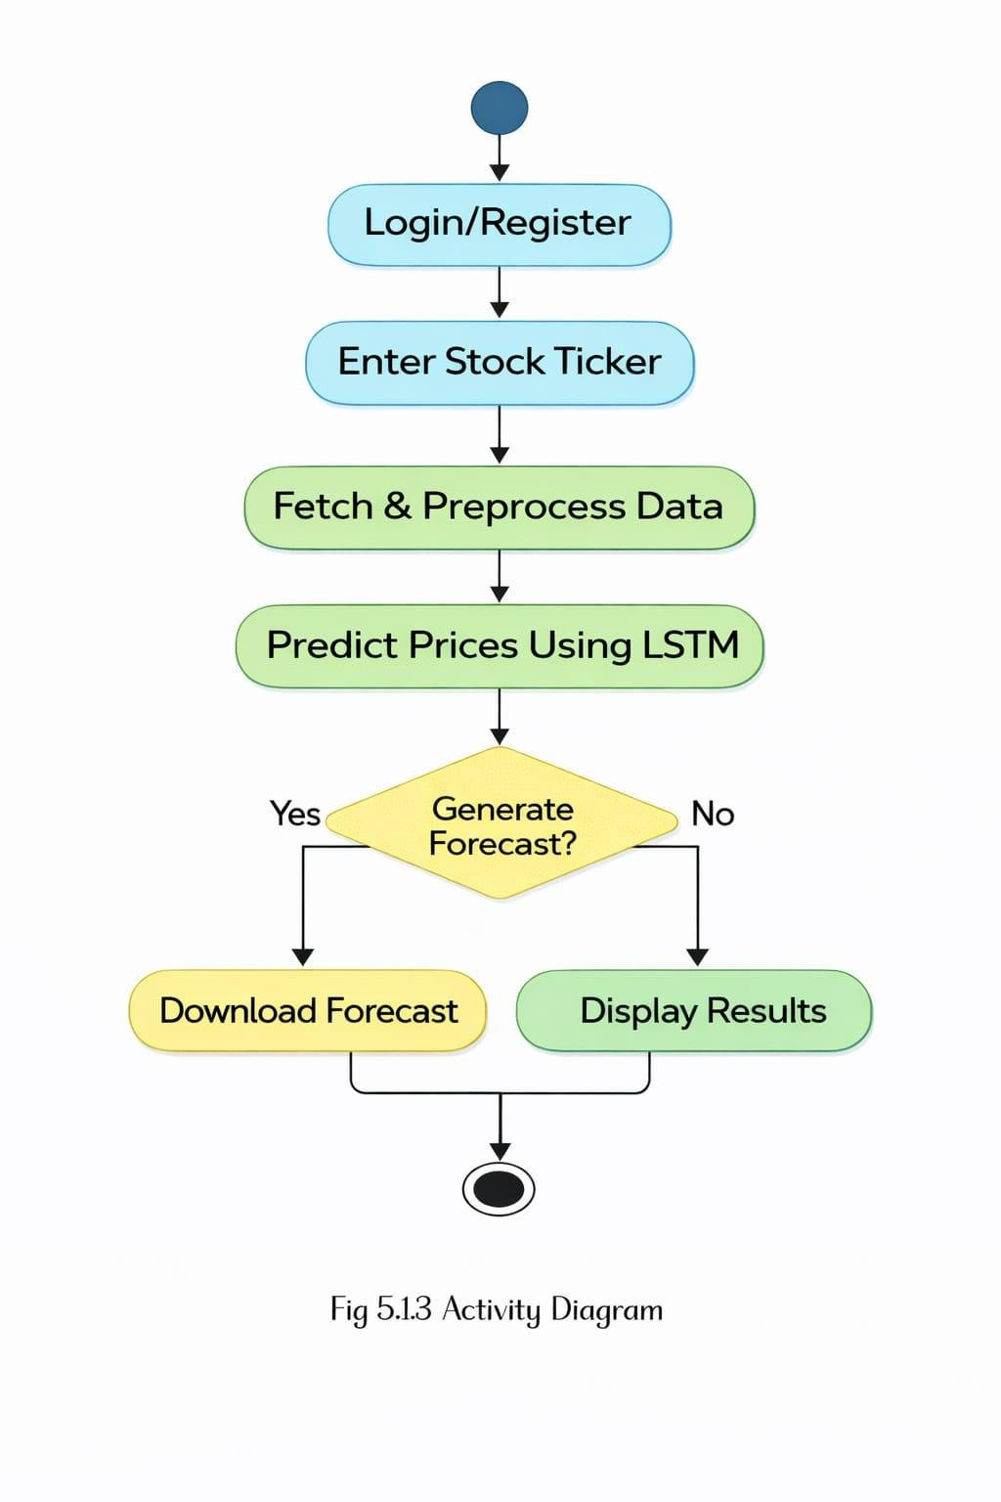
System Working
User opens app and logs in
Enters stock symbol
System collects data from yFinance
Data is processed and prepared
LSTM model predicts prices
System generates 7-day forecast (if needed)
Results and charts are shown

Slide 15
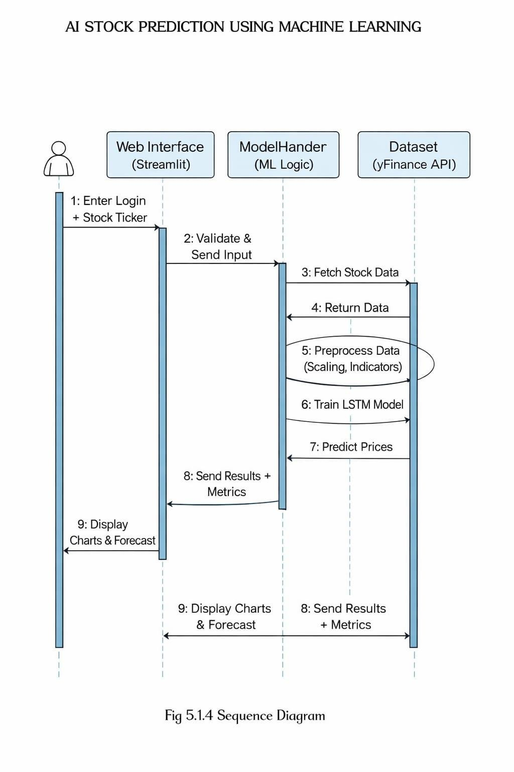
Sequence Diagram
User → Login → System verifies
User enters stock → Data fetched
Data is processed (scaling, indicators)
LSTM model trains and predicts
Results + accuracy (MAE, RMSE) calculated
Charts and predictions displayed

Slide 16
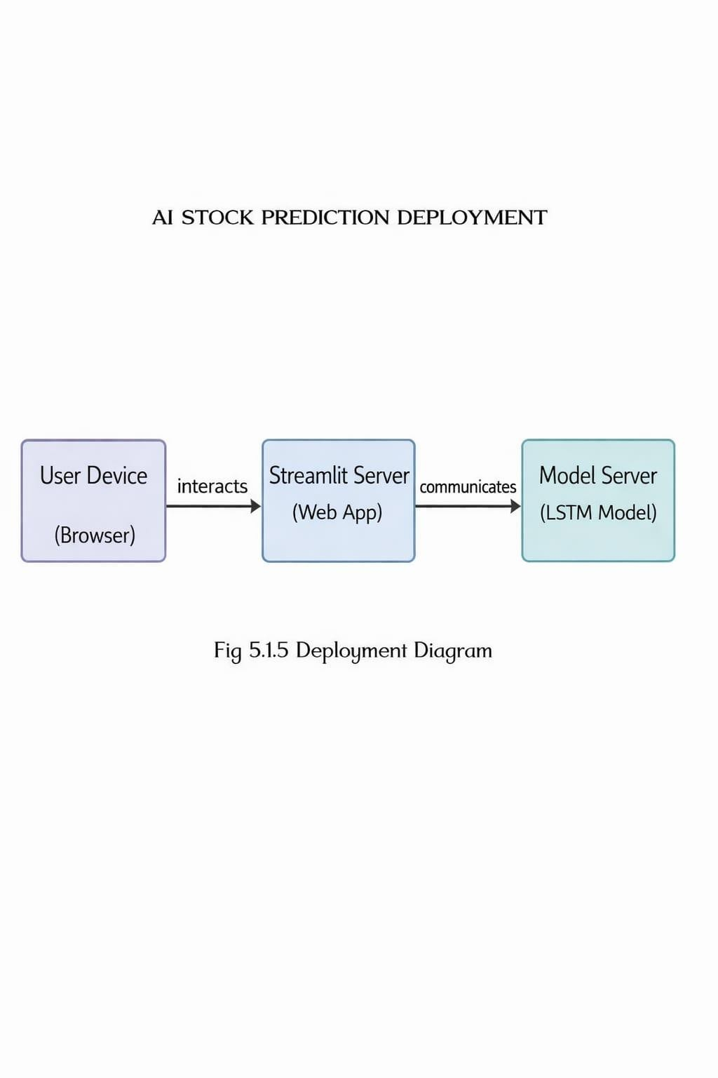
Deployment Diagram
User Device → Access through browser
Streamlit Server → Runs the web app
Model Server → Runs LSTM model
yFinance API → Provides stock data

Slide 17
ALGORITHM
1. Stacked LSTM Model Multiple LSTM layers are used for better accuracy.
2. Learns Time-Based Data Works well for stock data because it learns patterns over time.
3. Remembers Past Information Uses memory cells to store important past data.
4. Better than Normal Models Performs better than traditional methods and simple neural networks.
5. Handles Long-Term Patterns Captures trends and dependencies in stock prices

Slide 18
SOURCE CODE
from evaluation import evaluate_model
import streamlit as st
import pandas as pd import numpy as np import yfinance as yf import
plotly.graph_objects as go import matplotlib.pyplot as plt from
sklearn.preprocessing import MinMaxScaler from tensorflow.keras.models import Sequential from
tensorflow.keras.layers import LSTM, Dense from streamlit_autorefresh import st_autorefresh
import os from evaluation import evaluate_model # Make sure evaluation.py exists
# ---------------- PAGE CONFIG ---------------- st.set_page_config(page_title="AI Stock Prediction", layout="wide")

Slide 19
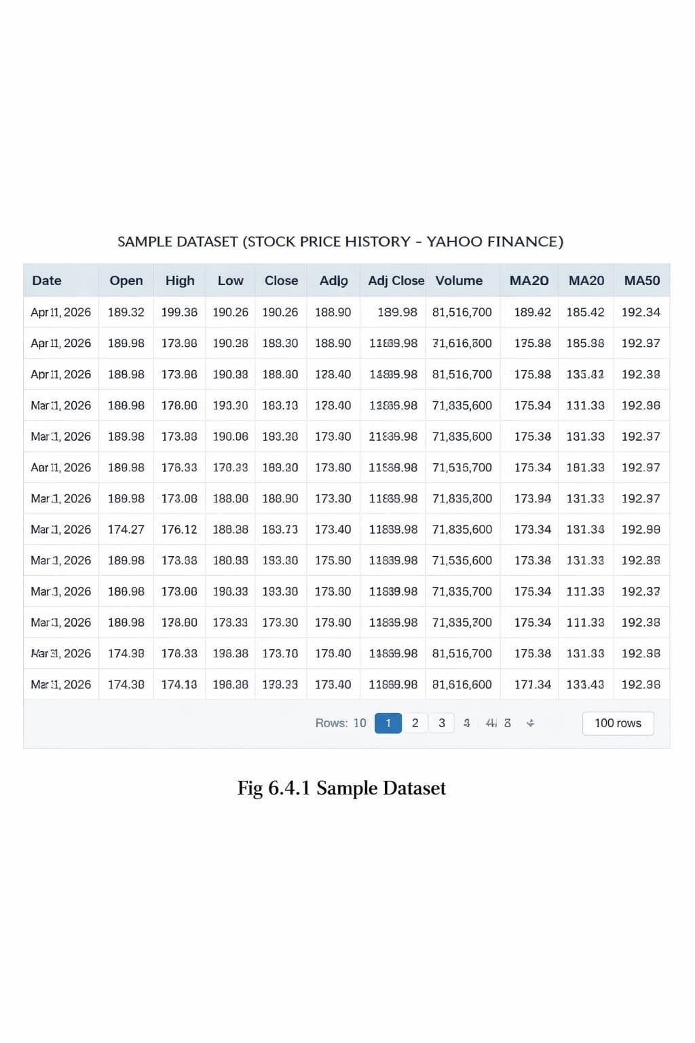
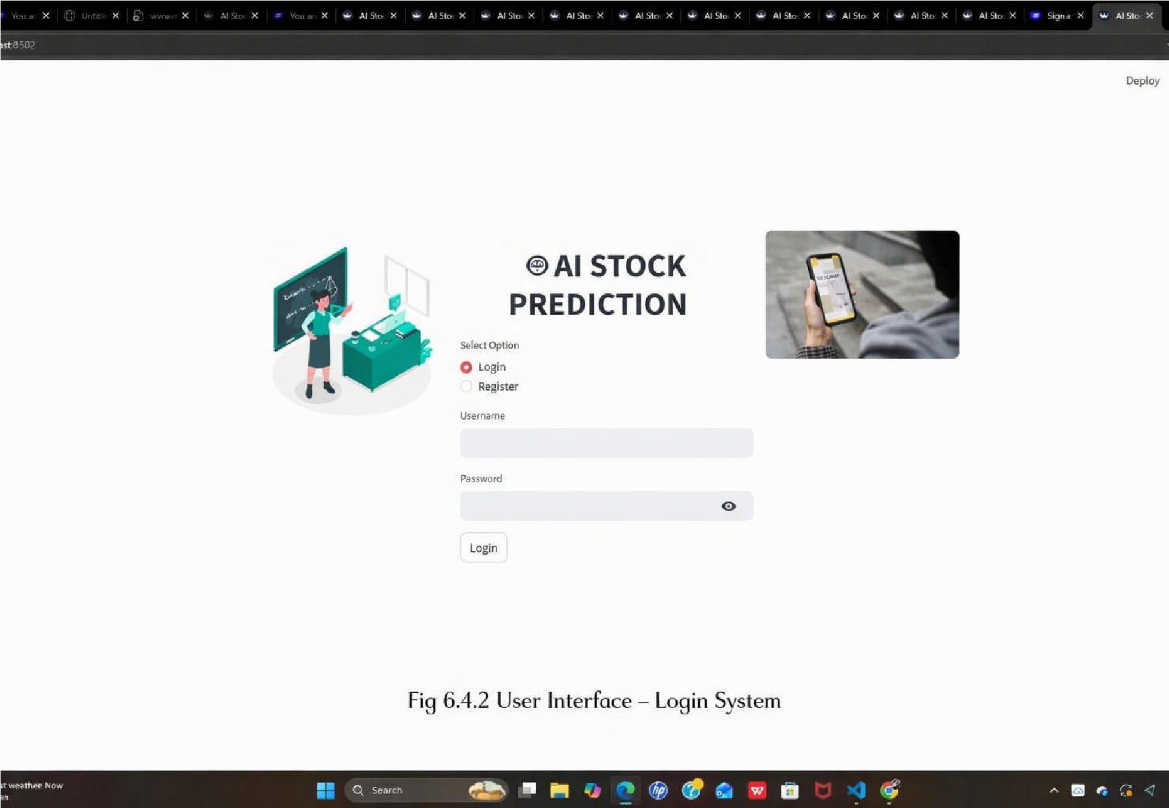
Screenshots

Slide 20
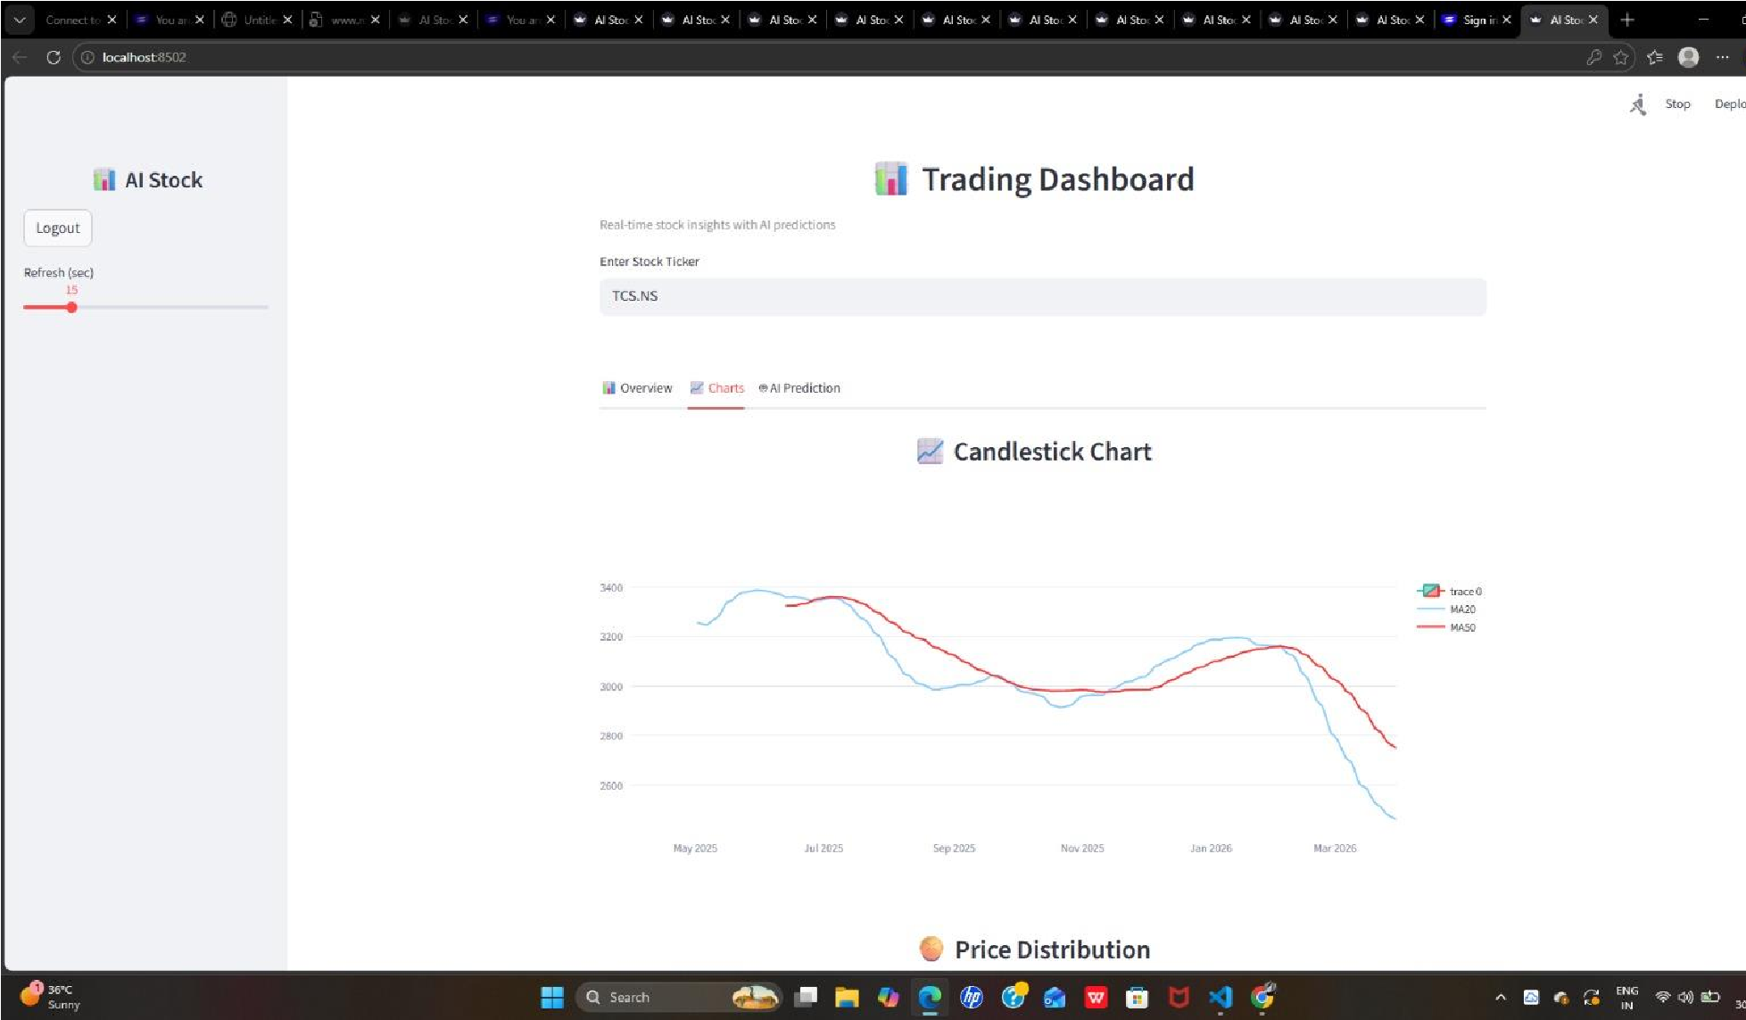
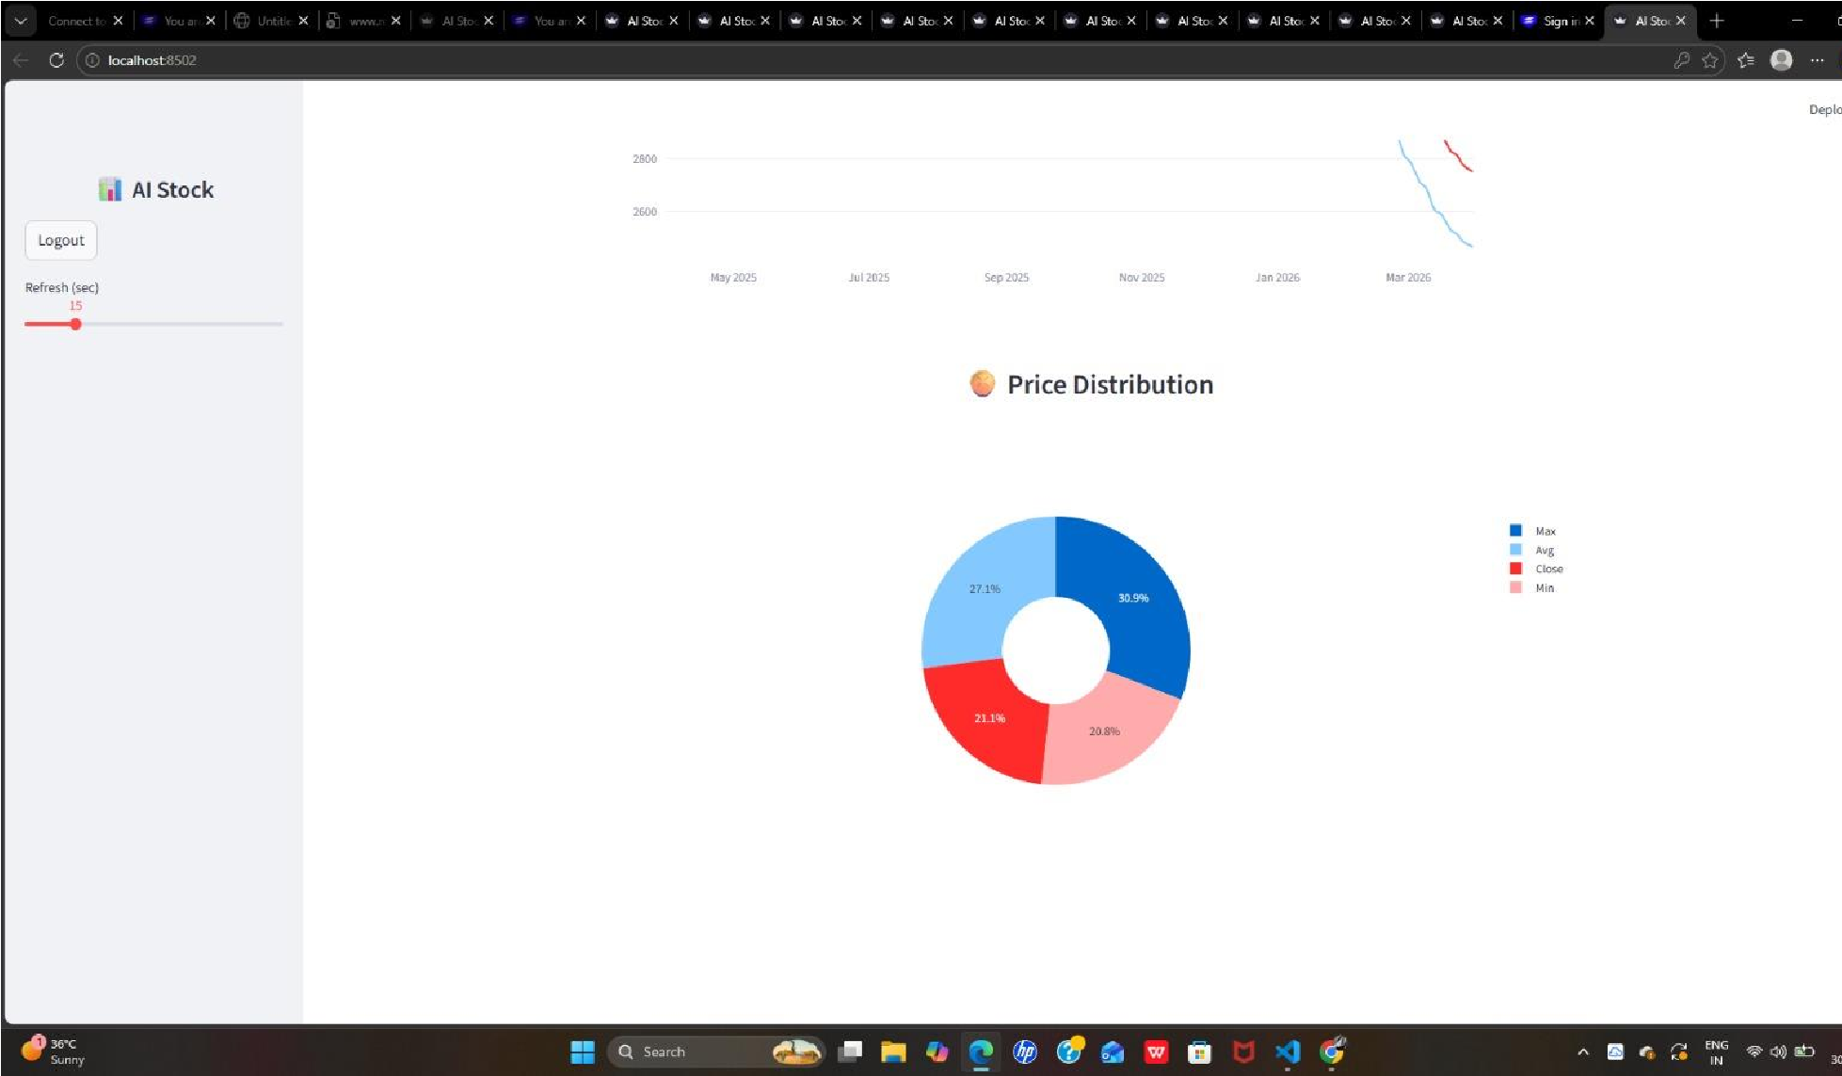

Slide 21
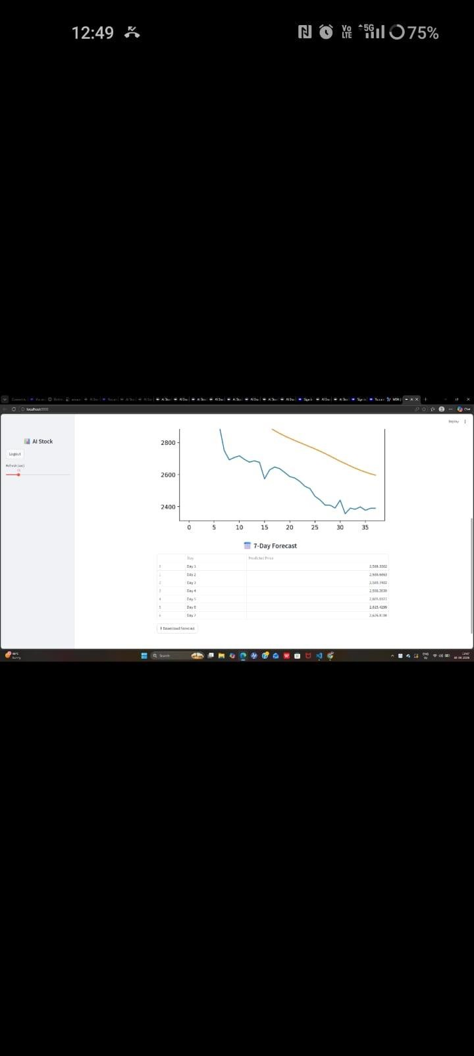

Slide 22
SIMPLE TESTING
Unit Testing
Tests each component separately
Checks data fetching from yahoo Finance API
Verifies data scaling using Min Max Scaler
Ensures correct creation of 60-step sequences
Validates technical indicators (MA20, MA50, RSI)
Checks LSTM prediction output format and accuracy

Slide 23
Model Integration Testing
Verifies complete flow from input to prediction
Checks API data is correctly processed
Ensures LSTM Tests how all modules work together
TM predictions are properly displayed
Validates MAE, RMSE, and accuracy calculations

Slide 24
Manual UI Testing
Checks login and registration functionality
Tests valid and invalid stock ticker inputs
Verifies charts (candlestick, graphs) display correctly
Ensures forecast CSV download works properly
Confirms dashboard works on different screen sizes

Slide 25
CONCLUSION
. The system is successfully developed using Deep Learning (LSTM) for stock
prediction
. It analyzes historical stock data to forecast future prices.
. Provides good prediction accuracy with reliable performance metrics.
. Integrates data collection, preprocessing, and prediction in one system.
. Offers a user-friendly interface using Streamlit dashboard.
. Includes real-time data, technical indicators, and trading signals.
. Helps users make better and informed investment decisions.
. Can be further improved with advanced models and additional features in the future.

Slide 26
FUTURE ENHANCEMENTS
Improve prediction accuracy using advanced models like GRU and Transformer
Combine models using hybrid techniques (CNN + LSTM) for better results
Add news and sentiment analysis (NLP) to understand market behavior
Support multiple stock comparison for better analysis
Include portfolio management features for tracking investments
Implement advanced indicators like MACD, Bollinger Bands, and volume analysis
Deploy system on cloud platforms (AWS, Azure, Google Cloud)
Improve security with encryption and two-factor authentication
Develop mobile app support using React Native or Flutter
Provide long-term forecasting (30-day, 90-day predictions)
Optimize performance using GPU acceleration and faster models
Add user personalization features like watchlists, alerts, and notifications

Slide 27
REFERENCES
Brownlee, J. (2017) Deep Learning for Time Series Forecasting, Machine Learning Mastery
Hochreiter, S., & Schmidhuber, J. (1997) Long Short-Term Memory, Neural Computation Journal, 9(8), 1735–1780
Pedregosa, F., et al. (2011) Scikit-learn: Machine Learning in Python, Journal of Machine Learning Research, 12, 2825–2830
TensorFlow Documentation https://www.tensorflow.org/
Keras Documentation https://keras.io/
Streamlit Documentation https://docs.streamlit.io/
Yahoo Finance API (yFinance) https://pypi.org/project/yfinance/
Plotly Python Library https://plotly.com/python/
Pandas Documentation https://pandas.pydata.org/docs/
NumPy Documentation https://numpy.org/doc

Slide 28
THANK YOU…

Slide 29
Queries…?

